Slide 1
T99X171.00 DOA Product Reboot/ Hang Up
FA Report
Prepared by : PE Long
Date : 2023/10/18

Slide 2
#1
Establish the Team
Team Leader
Team Member
PE: Michael, Long
ME: Cheng Lun, Hugo
PM: An Tran, Roisy
PD: Wen Yong
QA: Ken, Robert
TE: Allan, Jones
IE: Hai Ly, Heng Ruan
Foxconn
  MFG Director: David Yin
  QA Manager : CB Lin, Toney
Notes:
MA5800-X7#display cable modem <MAC> detail

Slide 3
#2
Problems description
Issue Description (5W2H)
When | 2023/07/27
Who | ALT customer
Where | SK networks warehouse, Anseong, Korea.
What | ALT customer feedback that they found out 1/1000pcs has Reboot/ Hang Up.
Why | Follow SoC material (P/N: 002.02753.005. DC: 2309, Vendor: AMLOGIC)
How | Abnormal reboot after system hangup (Unstable).
How many | 1/1000pcs ( F/R: 0.1%) as table below.
No | Description Issue | S/N | MAC | Fail rate
1 | Abnormal reboot after system hangup. | 2149688001202301146495 | BCF4D4F91707 | 0.1%
Notes:
MA5800-X7#display cable modem <MAC> detail

Slide 4
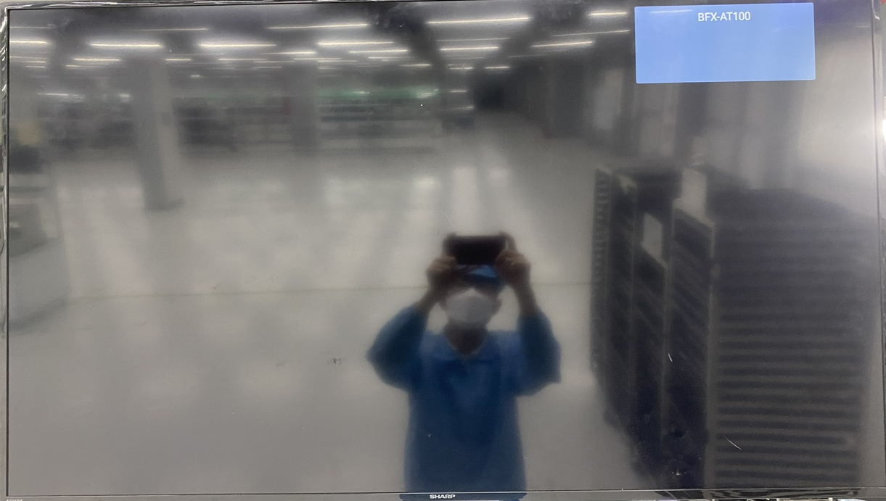
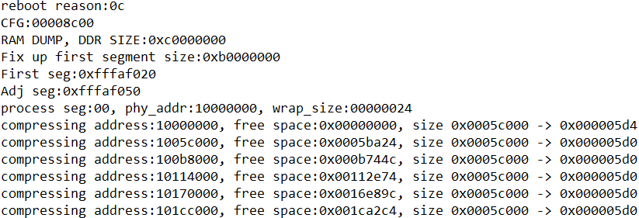
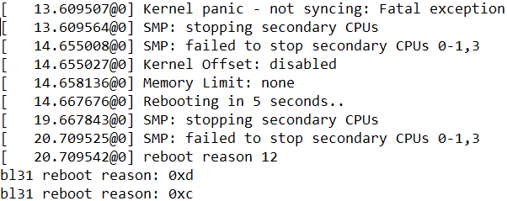


#3
Background Information
On 07/27, T99X171.00 model, ALT customer feedback that they found out 1/1000pcs has hang-up/ reboot.
Defect rate: 1/1000 =1000 DPPM
Fail symptom: NG board hang up/reboot issue
Screen hang-up or reboot
Console SW customer
Console SW factory
Summary:
Abnormal reboot after system hangup.
Notes:
5.26891E-07 4.96855E-07

Slide 5
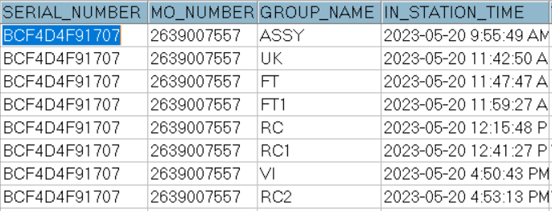
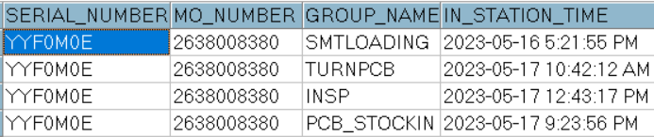
#4
System level
1. Recheck production data record.
2. Recheck test log
Dot level
T level
No# | Station | Status
1 | UK | Pass
2 | FT | Pass
3 | FT1 | Pass
4 | RC | Pass
5 | RC1 | Pass
6 | RC2 | Pass
Summary:
- Recheck production data record and test log ➔ Did not find out any abnormal.
Notes:
MA5800-X7#display cable modem <MAC> detail

Slide 6
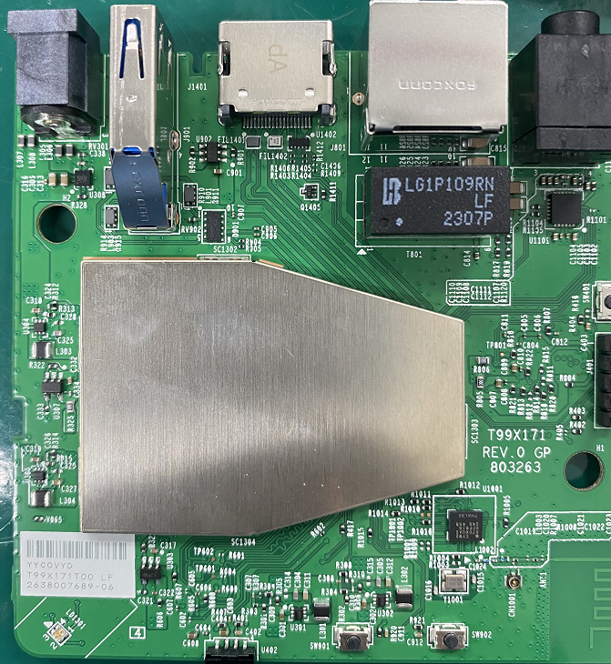
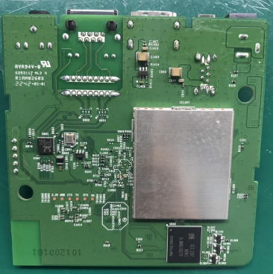
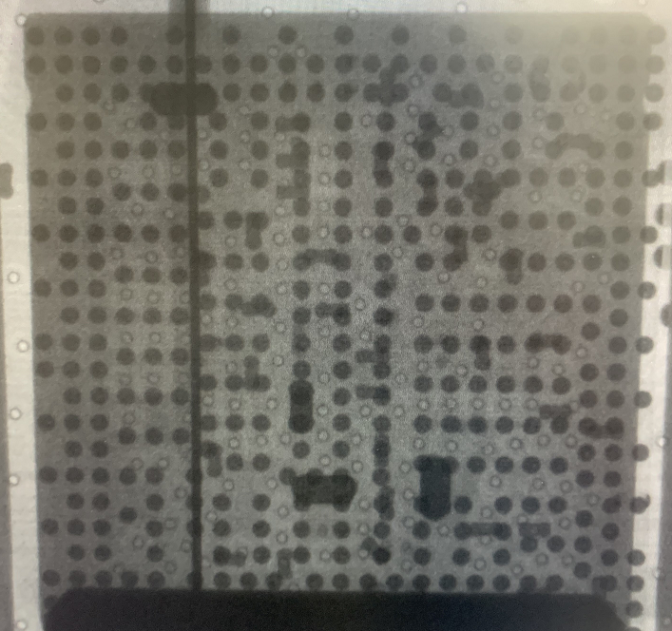
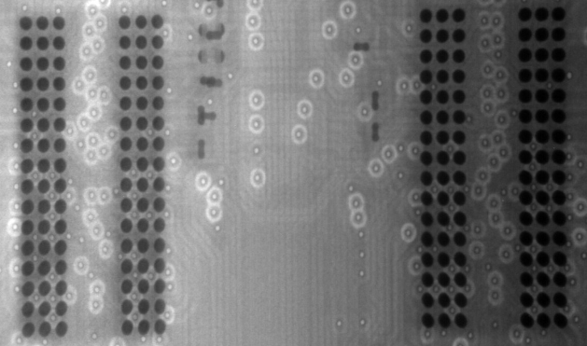
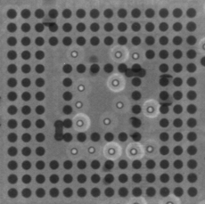
#5
Board level- 1
1. Check visual inspection and take X-ray NG sample, result as below:
Item | Top side | Bottom side
Visual inspection
Item | SoC | DDR | eMMC
X-Ray
Summary:
Don’t find out any abnormality at top/bottom side of NG boards.
Don’t find out process issue such as: Solder short ... on board .
Notes:
MA5800-X7#display cable modem <MAC> detail

Slide 7
#6
Board level- 2
2. SW verification:
Re-update factory image: k000b-523r06_SD_fac-20220118 and check power on
➔ NG board still auto reboot after booting about 5-20 minutes:
Summary:
Auto reboot still happen on factory image
Because NG board reboot after about 5-20minutes booting (unstable)) then after next is hang up/reboot FATP so can’t cover 100% this issue.
Notes:
5.26891E-07 4.96855E-07

Slide 8
#7
Board level- 3
3. Re-test at FATP
Retest NG board on FATP
Station | FT | FT1 | RC | RC1 | RC2
Seconds times | 31s | 120s | 100s | 4s | 4s
Result | PASS | PASS | PASS | PASS | PASS
Summary:
- Because NG board auto reboot after about 5-20minutes booting (unstable) then after next is hang up/reboot so FATP can’t cover this issue.
Notes:
5.26891E-07 4.96855E-07

Slide 9
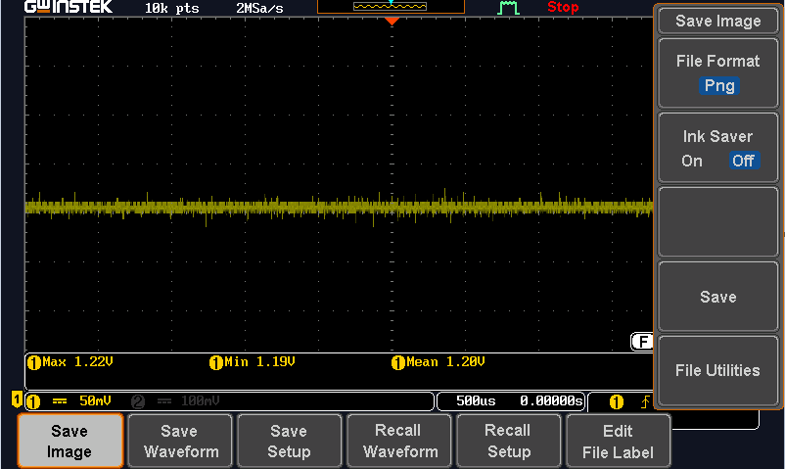
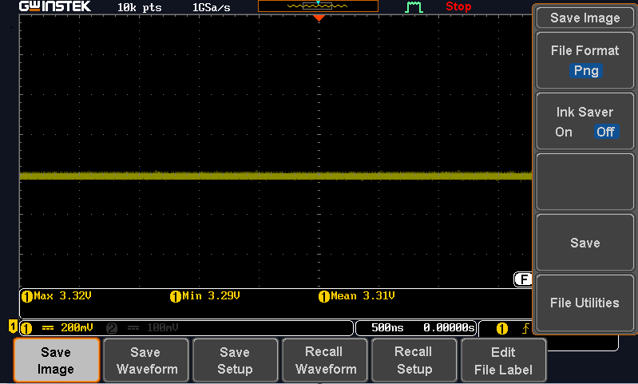
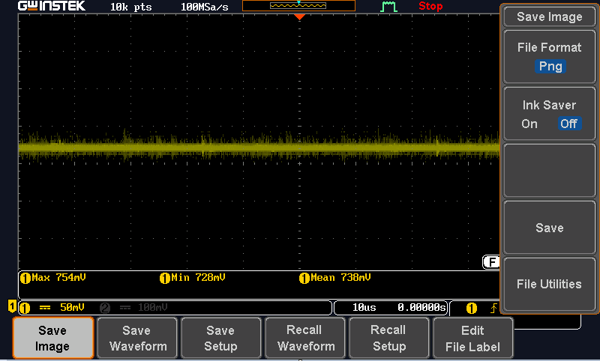

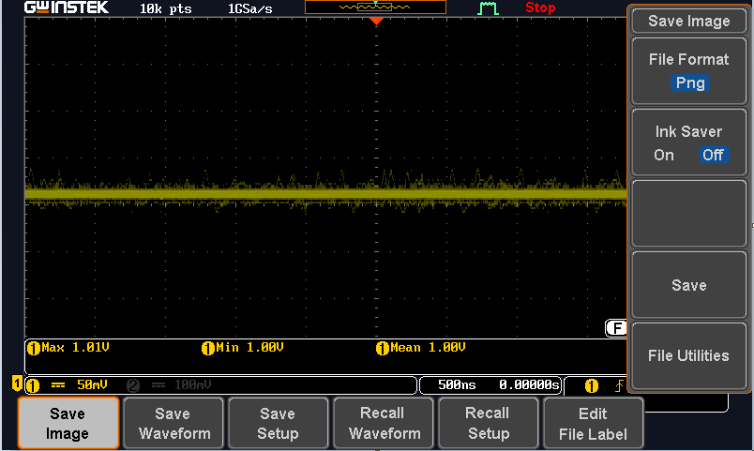
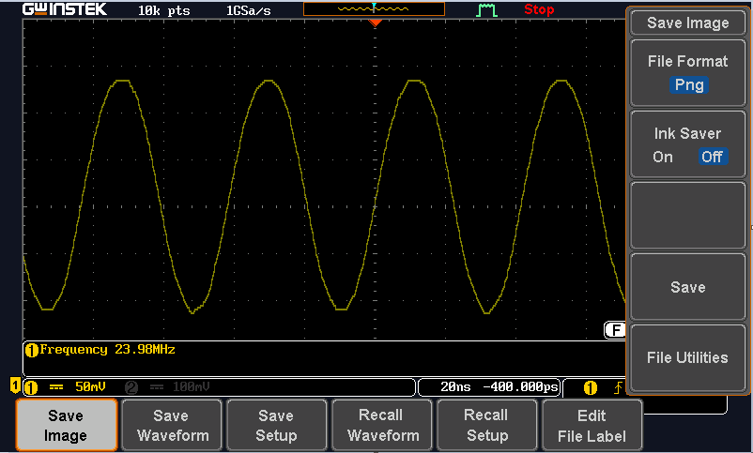
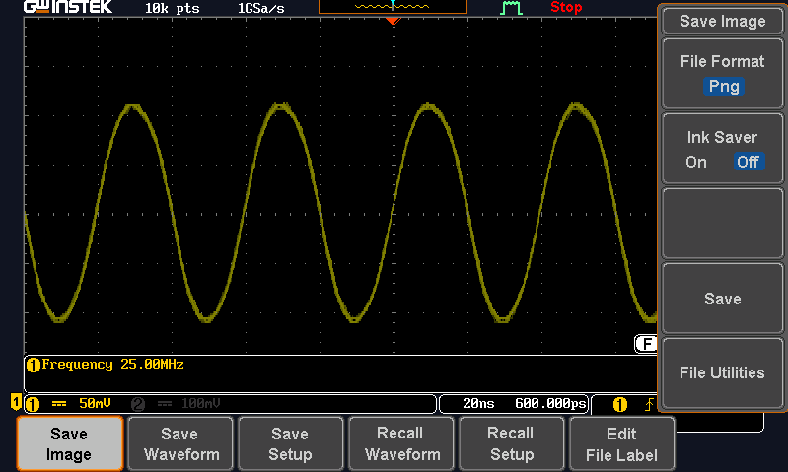
#8
Board level- 4
4. Check Vout noise of PCBA NG, result as table below:
Item | P1V2_Vout Spec (1.14V-1.26V) | P3V3_Vout Spec (3.135-3.465V) | VDDCPU_Vout Spec (0.73V-1.01V) | VDDEE_Vout Spec (0.68V-0.96V) | ETH_DVDD10_Vout Spec (~1.00V)
Compare Vout
1.20V
3.31V
0.738V
0.86V
1.00V
Item | Y401 | Y801
Compare Crystal
23.98Mhz
25Mhz
Summary:
➔ Don’t find out abnormal. Vout noise of NG board their value meet the spec
Notes:
5.26891E-07 4.96855E-07

Slide 10
#9
Board Level- 5
5. Swap SoC and retest:
- RD Cooper suggest us swap SoC U1 verify:
➔ Result : This issue follow SoC component.
Run-in product 10hours + check Power ON/OFF 5times | 1 | 2
OK board + OK SoC | PASS | PASS
NG board + NG SoC | Fail | Fail
OK board + NG SoC | Fail | Fail
NG broad + OK SoC | PASS | PASS
Summary:
- This issue follow SoC (P/N: 002.02753.005, DC: 2309,Vendor: AMLOGIC) material have issue.
Notes:
MA5800-X7#display cable modem <MAC> detail

Slide 11
#10
Conclusion
Root cause:
Occur cause: Follow SoC material (P/N: 002.02753.005. DC: 2309, Vendor: AMLOGIC)
Escape cause: FATP can’t cover this issue
Action:
Recheck data on Y2023 produce q’ty 250000pcs, OBA tested 4195pcs not find out the same issue
PE suggest add run-in and power ON/OFF station on next buid.
Send FA report and NG SoC material to vendor AMLOGIC for futher analyzing. Owner: SQE Naomi.
Due date: 10/21
RD co-work with AMLOGIC taking action for this issue. Owner: RD Cooper. Due date: ASAP
Notes:
MA5800-X7#display cable modem <MAC> detail

